Slide 1
MAT 350
Differential Equations
Laplace Transformation
Inverse Laplace Transformation
Lecture: 9, Part-A
Dr. M. Sahadet Hossain (Mth)
Professor
Department of Mathematics and Physics, NSU.

Slide 2
REFERENCE:
Chapter- 7- The Laplace Transform
Book- A First Course in Differential Equations with Modeling and Applications, (10th Edition), Author-Dennis G. Zill.
Associated Sections: 7.1, 7.2 and 7.3
REVIEW MATERIAL (What I expect you already know/learnt from MAT 130)
  ● Improper integrals with infinite limits of integration
  ● Integration by parts and partial fraction decomposition

Slide 3
In mathematics, the Laplace transform is an integral transform named after its inventor Pierre-Simon Laplace (French scholar and mathematician). It transforms a function of a real variable t (often time) to a function of a complex variables (complex frequency). The transform has many applications in science and engineering.
Source- Wikipedia

Slide 4
Chapter 7.1
Definition of Laplace Transformation
The Laplace Transform is a linear operator that transforms a real function f(x) to a complex function F(ω). Note that x is a real variable, whereas ω=α+iβ is a complex variable.
In engineering, Laplace Transformation transforms a time function f(t) to a frequency function F(s). Note that t is a real and s is complex.
Objective:
a)Find solution to differential equation using algebraic relation.
b) A particular solution can be obtained without finding the general solution.
c) Analysis of various engineering and business model problems are very handy and effective.

Slide 5
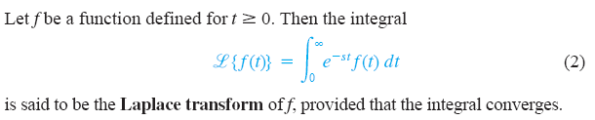
Laplace Transform: Definition
Note that
t is real, s is complex. Hence, f(t) is a real function whereas
F(s) is a complex function.

Slide 6

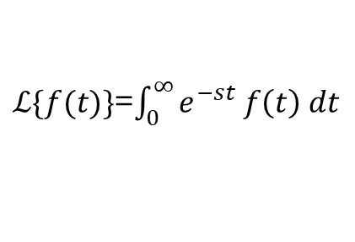



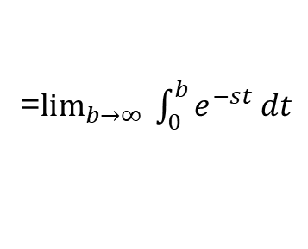

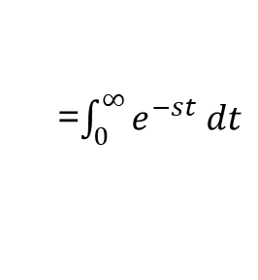


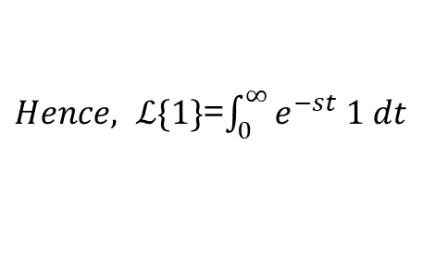


$\text{Evaluate} ℒ\{1\}$, here f(t)=1
$ℒ\{f(t)\}$=$\int_{0}^{∞}{e^{−st} f\left(t\right) dt}$
$Hence, ℒ\{1\}$=$\int_{0}^{∞}{e^{−st} 1 dt}$
=$\int_{0}^{∞}{e^{−st} dt}$
=$\lim_{b→∞}{ \int_{0}^{b}{e^{−st} dt}}$
$$ℒ\{1\}$$
=$\left(\frac{1}{−s}\right) \lim_{b→∞}\left[e^{−sb}−1\right]{ }$
=$\lim_{b→∞}{\left[\frac{e^{−st}}{−s}\right]}_{0}^{b}{ }$
=$\left(\frac{1}{−s}\right) \left[0−1\right]{ }$
=$\left(\frac{1}{−s}\right) \lim_{b→∞}\left[e^{−sb}−e^{0}\right]{ }$
Provided that s>0, otherwise the integral is divergent
=$\left(\frac{1}{−s}\right) \left[−1\right]{ , s>0 }$
$$ℒ\{1\}$$
= $\frac{1}{s}$ , $s>$0

Slide 7

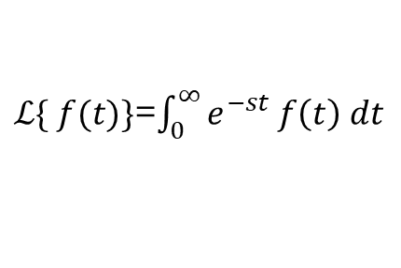


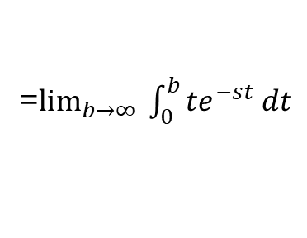

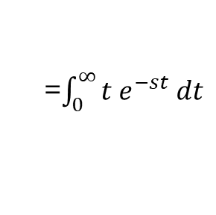
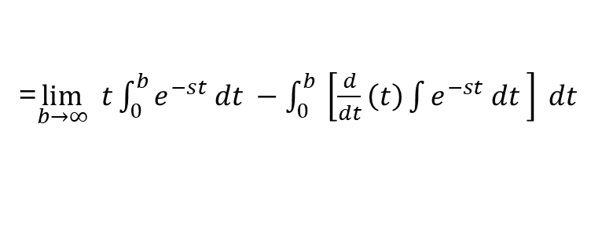
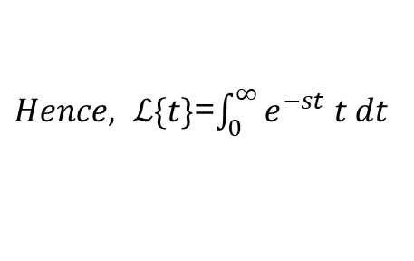
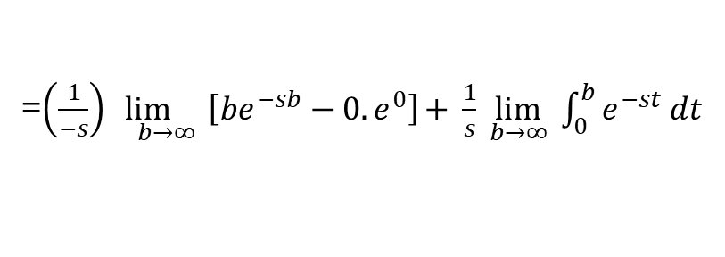
$$\text{Evaluate} ℒ\left\{t\right\}, Here f\left(t\right)=t$$
$ℒ\{ f(t)\}$=$\int_{0}^{∞}{e^{−st} f\left(t\right) dt}$
$Hence, ℒ\{t\}$=$\int_{0}^{∞}{e^{−st} t dt}$
=$\int_{0}^{∞}{{t e}^{−st} dt}$
LIATE
=$\lim_{b→∞}{ \int_{0}^{b}{{te}^{−st} dt}}$
=$\lim_{b→∞} t{\int_{0}^{b}{e^{−st} dt −\int_{0}^{b}{ \left[\frac{d}{dt}\left(t\right)\int{e^{−st} dt }\right] dt} }}$
=$\lim_{b→∞}{\left[\frac{{te}^{−st}}{−s}\right]}_{0}^{b}−\lim_{b→∞}\int_{0}^{b}{ \left[1. \frac{e^{−st}}{−s}\right] dt}{ }$
=$\left(\frac{1}{−s}\right) \lim_{b→∞}\left[{be}^{−sb}−{0.e}^{0}\right]{+ \frac{1}{s}\lim_{b→∞}{ \int_{0}^{b}{e^{−st} dt}}}$
=$\left(\frac{1}{−s}\right) \left[0−0\right]+{\frac{1}{s}∙ \frac{ 1}{s}}$
Provided that s>0, otherwise the integral is divergent
=$\frac{1}{s^{2}}$, s > 0.

Slide 8

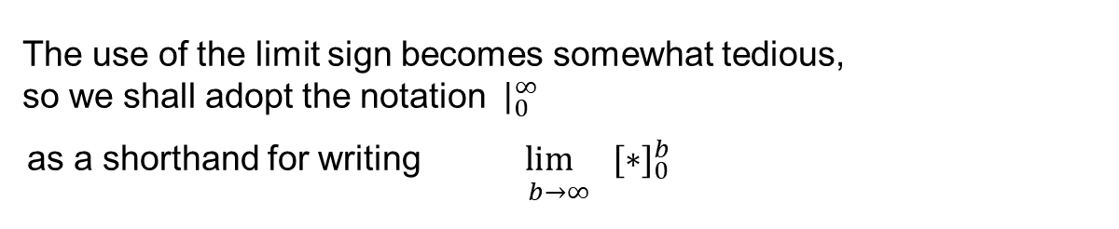
The use of the limit sign becomes somewhat tedious, so we shall adopt the notation${ \left. \right|}_{0}^{∞}$
as a shorthand for writing $\underset{b→∞}{lim {[∗]}_{0}^{b}}$
For example,
$\lim_{b→∞}{\left[\frac{{te}^{−st}}{−s}\right]}_{0}^{b}$ will be denoted by ${ \left. \frac{{te}^{−st}}{−s}\right|}_{0}^{∞}$

Slide 9
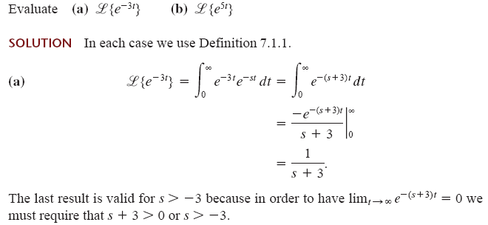

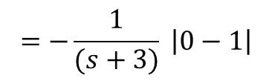
$$=−\frac{1}{(s+3)} \left|e^{−\left(s+3\right)∞}−e^{0}\right|$$
$$=−\frac{1}{(s+3)} \left|0−1\right|$$

Slide 10
>
>

Slide 11

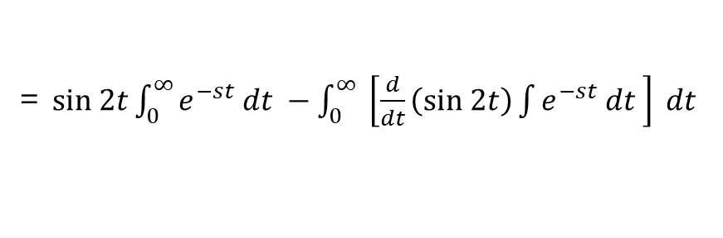

Solution: According to definition of Laplace Transformation
=$sin 2t{\int_{0}^{∞}{e^{−st} dt −\int_{0}^{∞}{ \left[\frac{d}{dt}\left(sin 2t\right)\int{e^{−st} dt }\right] dt} }}$
=${\left.\frac{e^{−st}}{−s}sin 2t\right|}_{0}^{∞}{−\int_{0}^{∞}{ \left[2cos 2t ∙\frac{e^{−st}}{−s}\right] dt}}$
$=−\frac{1}{s}$ (0-0) +
Cont. to next page
>

Slide 12
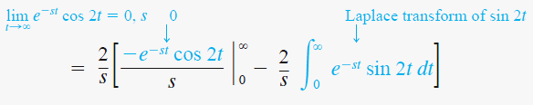



>
>
$=−\frac{2}{s^{2}} \left(0−1\right)−\frac{4}{s^{2}}$
Hence, (1+$\frac{4}{s^{2}}$)
$$\left(\frac{s^{2}}{s^{2}+4}\right). \frac{2}{s^{2}}$$
>

Slide 13
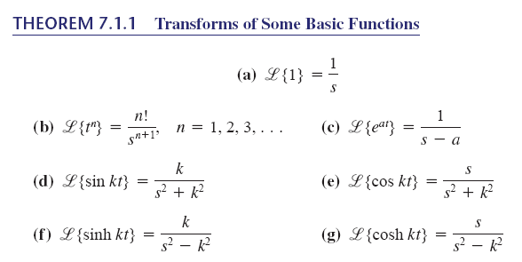

Slide 14

DEFINITION : Exponential Order
A function f is said to be of exponential order if there exist constants c, M> 0, and T> 0 such
for all t> T.
>
Properties of Laplace Transform :

Slide 15
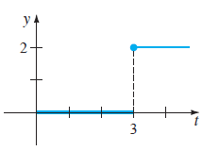
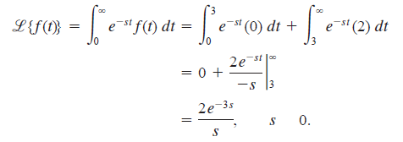
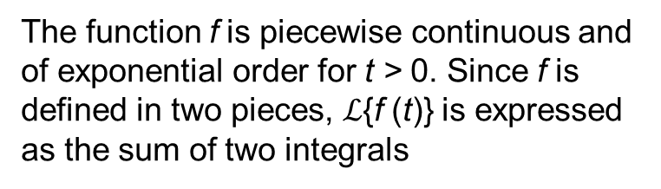
The function f is piecewise continuous and of exponential order for t > 0. Since f is defined in two pieces, $ℒ${f (t)} is expressed as the sum of two integrals
>

Slide 16
Chapter 7.2
Inverse Transforms and Transforms of Derivatives
REVIEW MATERIAL
● Partial fraction decomposition
● See the Student Resource Manual

Slide 17
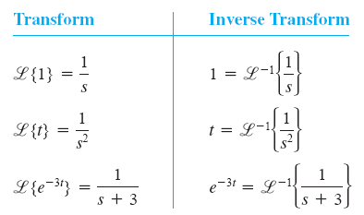
Inverse Laplace Transforms:
Laplace Transformation
Inverse Laplace Transformation

Slide 19




Solution:
We know$ℒ\{t^{4}\}$= $\frac{4!}{s^{5}}$
Therefore, ${ℒ }^{−1}$( $\frac{4!}{s^{5 }}$)=${ t}^{4}$
But, we are given to evaluate ${ℒ }^{−1}$( $\frac{4!}{s^{5 }}$)
Hence, we w$e do the following:$

Slide 20


Evaluate
Solution:
We know
In the given problem,
y

Slide 21

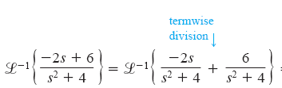



Slide 22
Solving Linear ODE Using Laplace Transform
Summarizing the process:

Slide 23
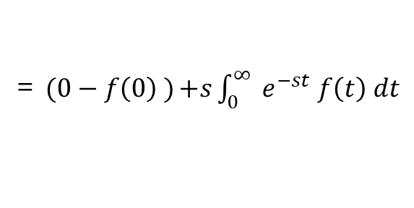
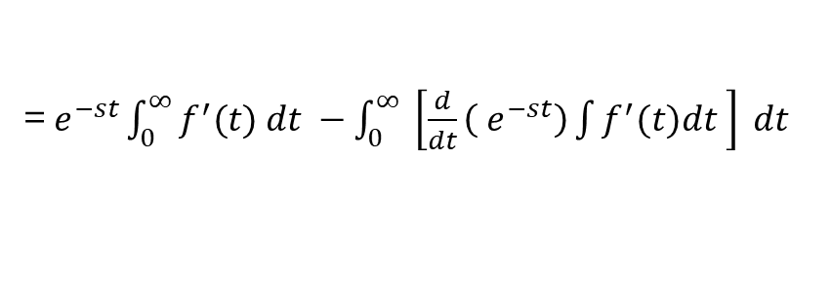
Derivatives of Laplace Transformation
Let,
and
=${ e}^{−st}{\int_{0}^{∞}{f^{′}(t) dt −\int_{0}^{∞}{ \left[\frac{d}{dt}\left({ e}^{−st}\right)\int{f^{′}(t)dt }\right] dt} }}$
=$(0−f\left(0\right) ){+s\int_{0}^{∞}{{ e}^{−st} f\left(t\right) dt}}$

Slide 24
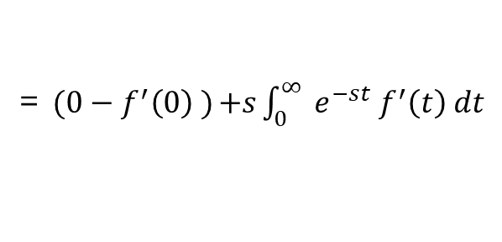
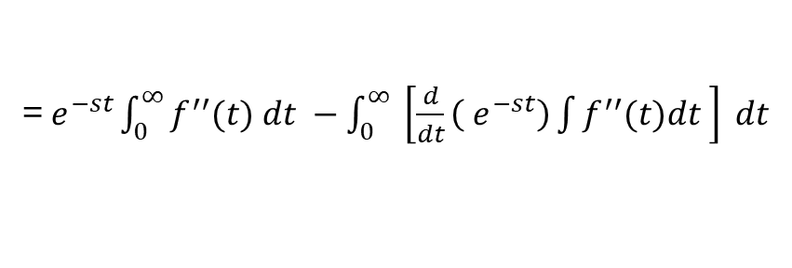
Derivatives of Laplace Transformation
=${ e}^{−st}{\int_{0}^{∞}{f^{′′}(t) dt −\int_{0}^{∞}{ \left[\frac{d}{dt}\left({ e}^{−st}\right)\int{f^{′′}(t)dt }\right] dt} }}$
=$(0−f^{′}\left(0\right) ){+s\int_{0}^{∞}{{ e}^{−st}{ f}^{′}\left(t\right) dt}}$

Slide 25
Derivatives of Laplace Transformation
Recall, for understanding

Slide 26




Problem:
Solution:
Taking the Laplace Transformation on both sides
$$s^{2}Y\left(s\right)−s.1−5−3\left[ sY\left(s\right)−1\right]+2 Y\left(s\right)=\frac{1}{s+4}$$
$$s^{2}Y\left(s\right)−s−5−3 sY\left(s\right)+3 +2 Y\left(s\right)=\frac{1}{s+4}$$

Slide 27
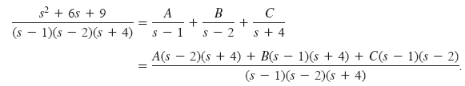

Now, use the partial fraction as
For, s=1, we have
So, A= -16/5
For, s=2, we have
So, B= 25/6

Slide 28


For, s= -4, we have
So, C= 1/30
Therefore,
Taking the inverse Laplace on both sides

Slide 29



Exercise 7.2 (9th Edition)
Solving
Y(s)=
The Inverse Laplace hence gives

Slide 30




Solving
The Inverse Laplace hence gives

Slide 31
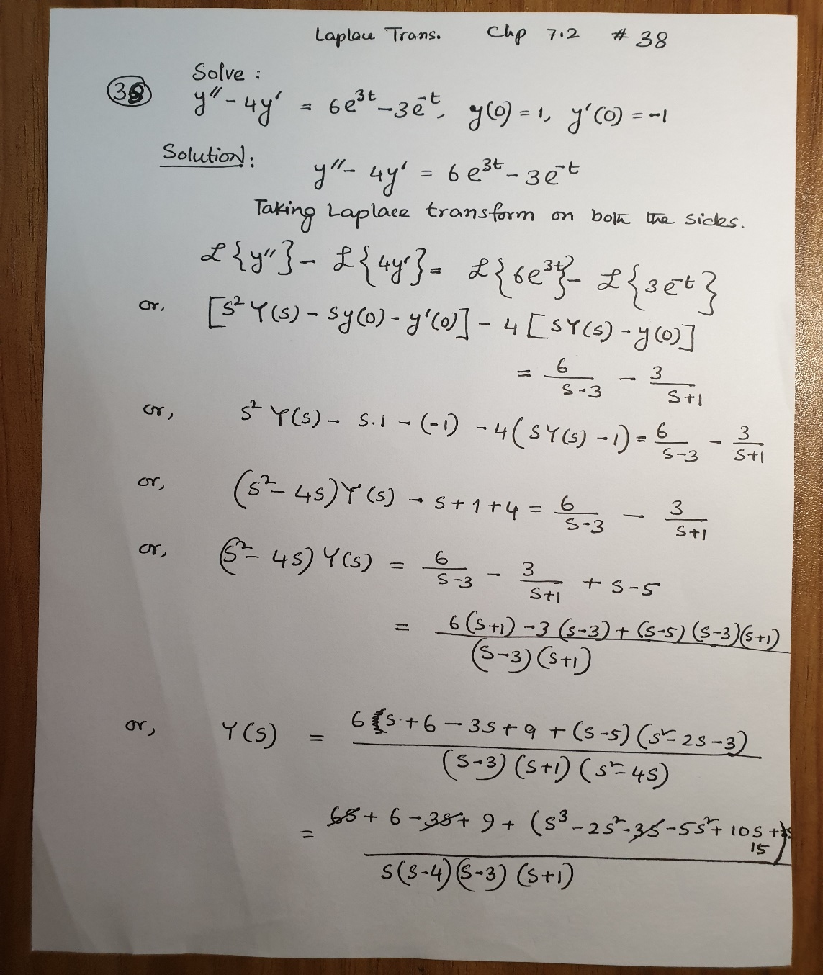
38
Cont. to next page

Slide 32
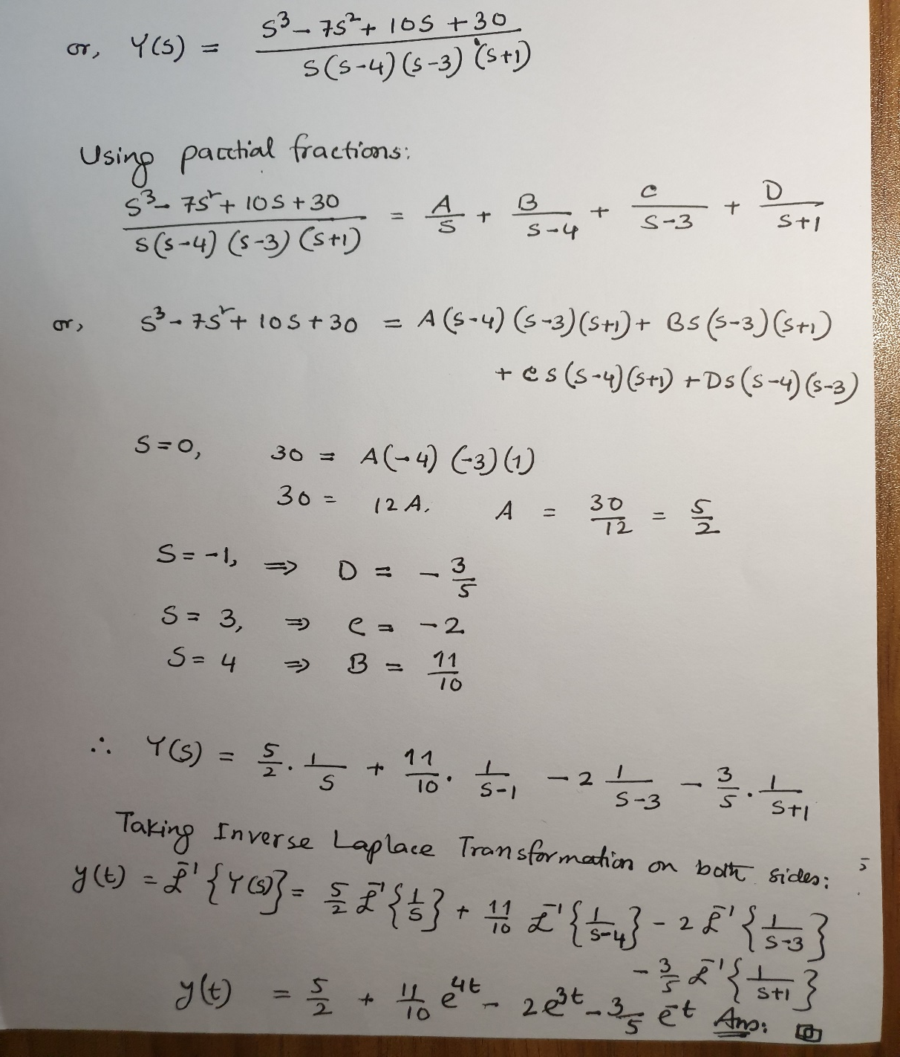

Slide 33
To Do List
Chapter 7.1
Problems#2,5,12,18,31
Chapter 7.2
Problems#2,11,19,22,35,36,37,38

Slide 34
Thank You.

